Slide 1
Virtual Labs
Making engineering education engaging, effective, immersive and online
December 2016

Slide 2
Engineering education scenario of India
Out of about 4000 engineering colleges
20% are employable
*Only about 100 offer good quality education
**Out of 1.5 million engineering graduates that pass out every year, only about 20% are employable.
Reference:
*Top 100 Engineering Colleges in India http://www.outlookindia.com/article/top-100-engineering-colleges-in-2015/294646
**Engineering graduates every year
http://dazeinfo.com/2014/10/28/1-5-million-engineering-pass-outs-india-every-year-fewer-getting-hired-trends/
© 2016, IIIT Hyderabad

Slide 3
Problems with engineering education
Absence of good faculty
Poor quality of laboratory equipment and facilities
Absence of good infrastructure
Lack of exposure of students to research
Poor exposure to industry practices
Large gap/disconnect between theory and practicals
Poor alignment between Industry needs and College curricula
Lack of coherent Learning Objectives for Laboratories
-
Free Access to Good quality Labs enable students to ‘learn to do’ and internalize the content.
They become more proficient and employable

Slide 4
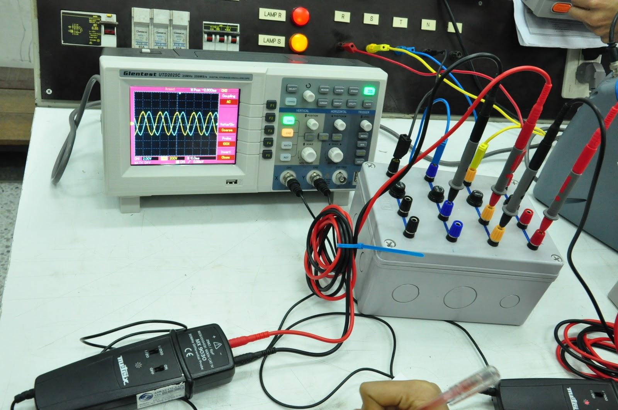
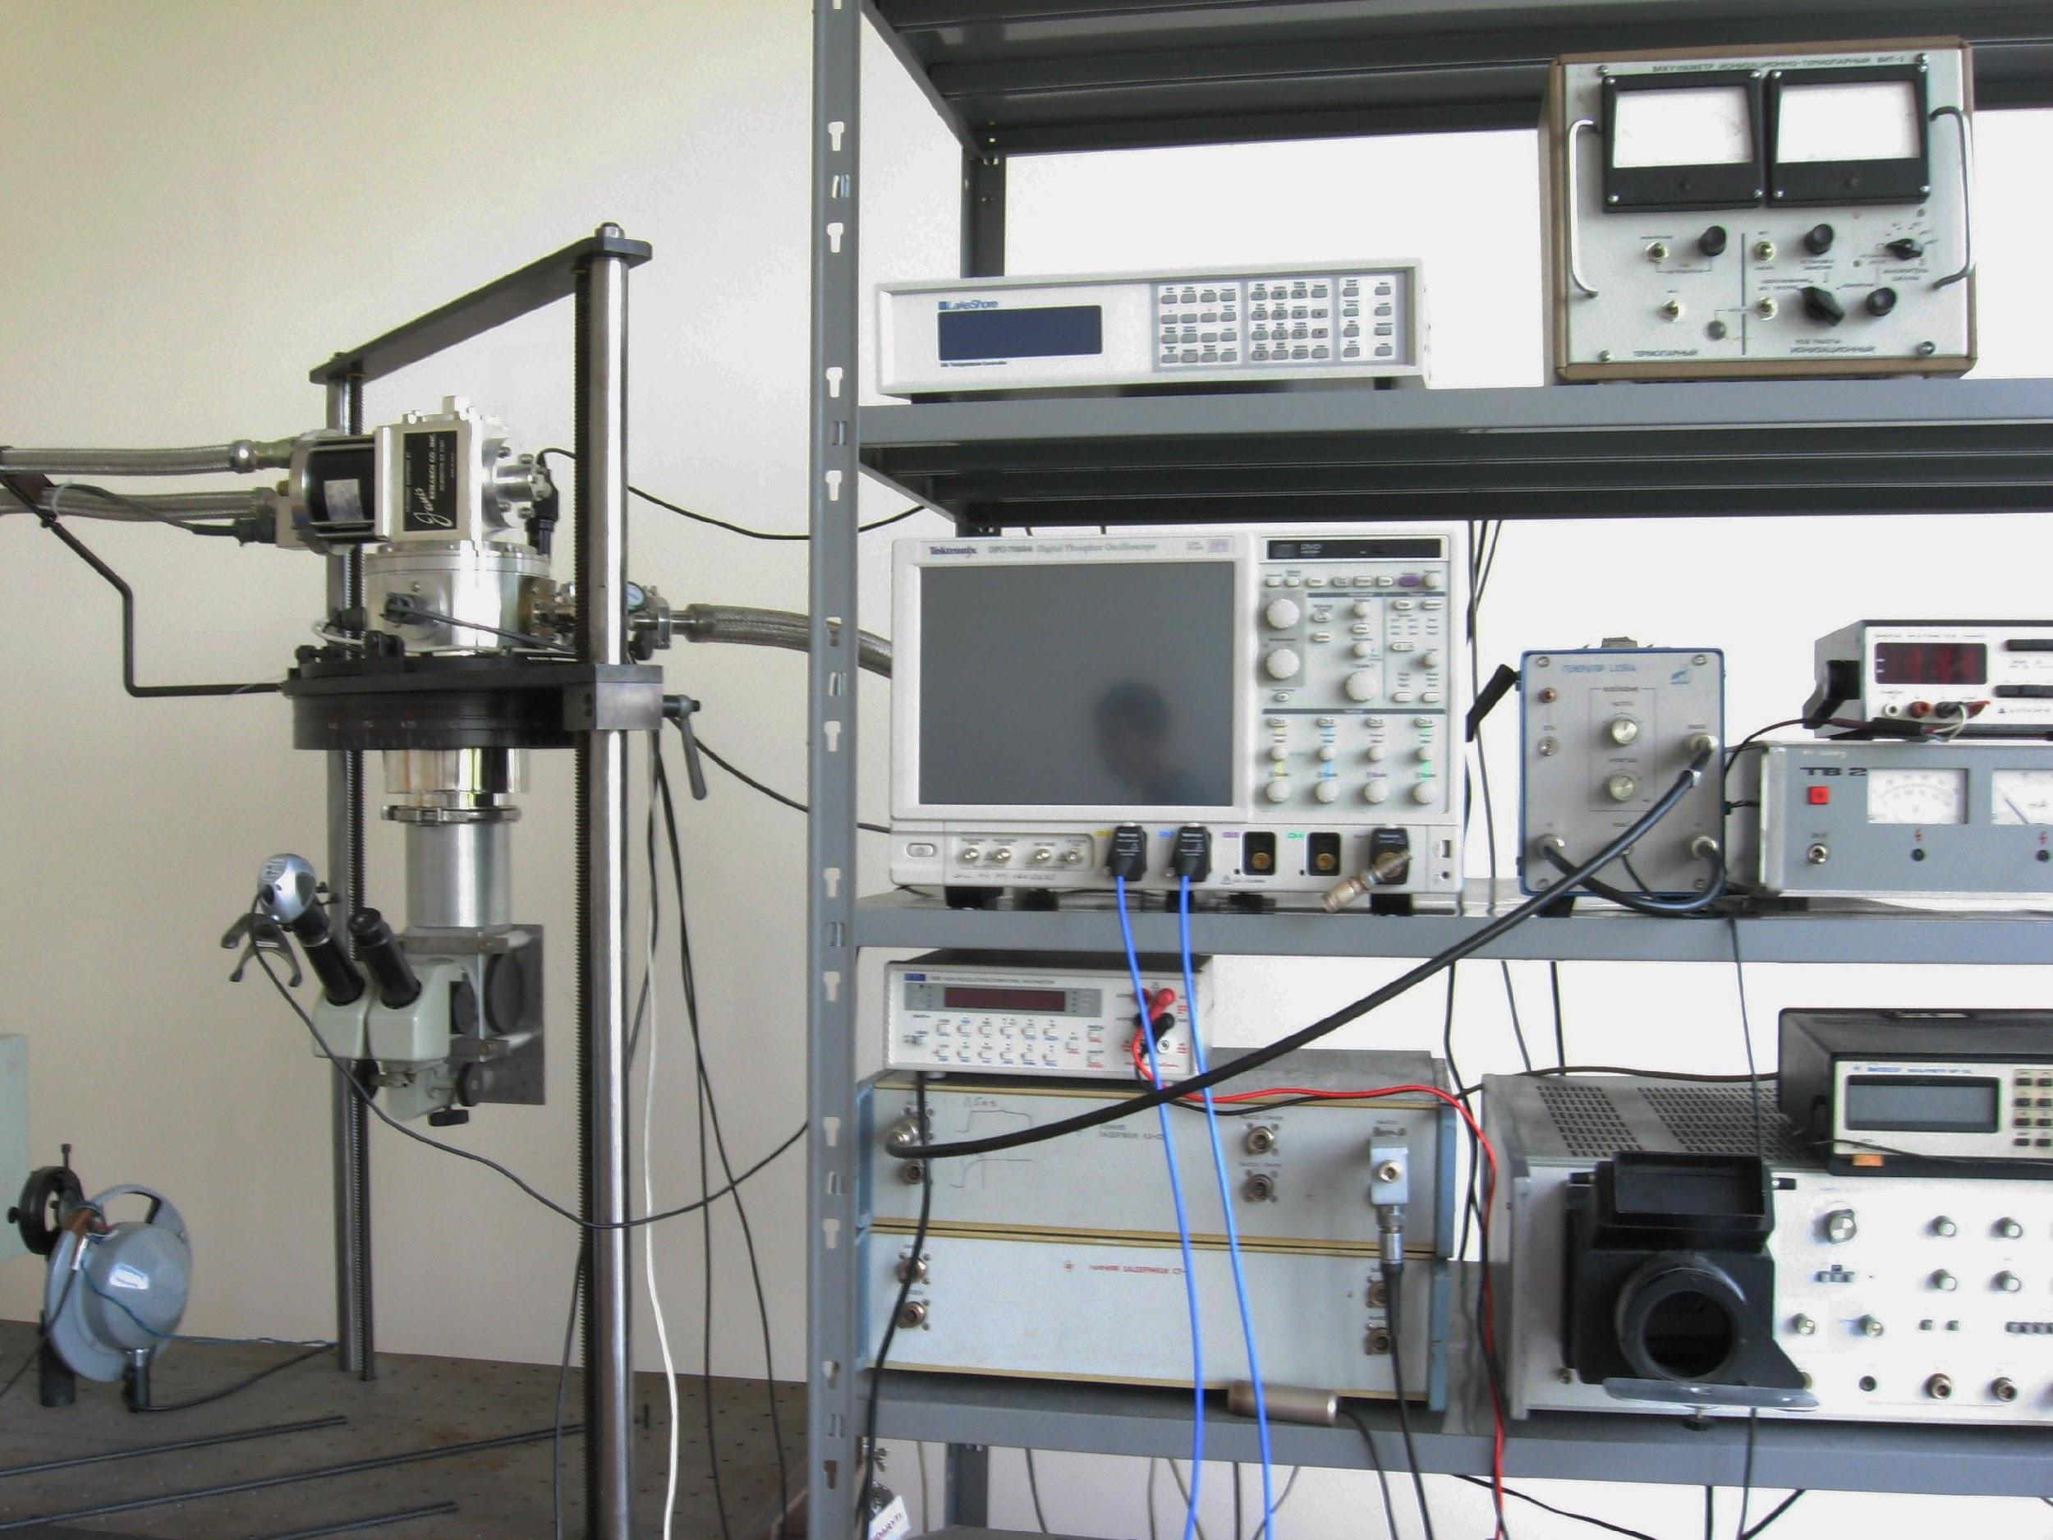
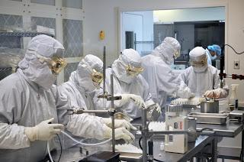
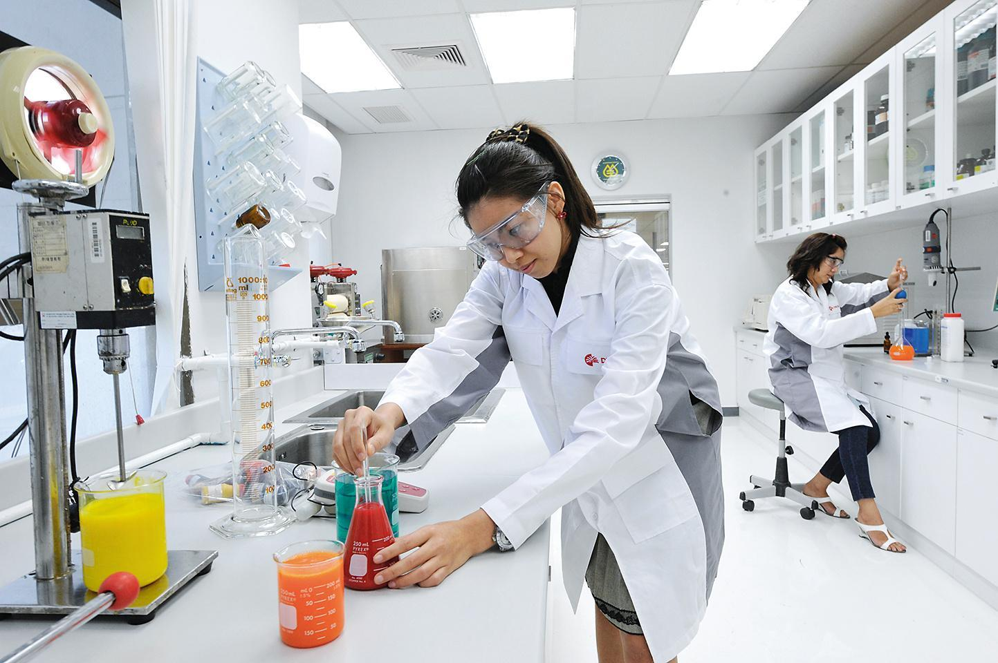
Importance of a Lab
A lab is a critical component of engineering education.
Science and engineering is a study of natural phenomena. This requires students to work in a laboratory to promote discovery and creativity.

Slide 5
Relevance of Virtual Labs
Problems with Physical Labs
Virtual Labs – Potential Solution
Expensive (reagents, equipment)
Access to lab - not available all the time
Hazardous
High dependence on trained teachers and assistants
Simulate a experiment online
Watch videos or animations of experiments
Access a physical laboratory remotely
“Virtual Labs” offers all the above
Virtual Labs are available anywhere, anytime, any lab – and highly scalable
© 2016, IIIT Hyderabad

Slide 6
Benefits to Key Stakeholders
Benefits for Teachers
Benefits For Students
Efficient & useful teaching aid
Contribute to the development of Virtual Labs
Use Virtual Labs to supplement the curriculum
Internship opportunities for students
Institute Best Practices available from Leaders
Easy online access to labs at all times
Physical distance no longer limits the learning process
Perform experiments remotely as and when needed
Access to high quality resources for free
Internship opportunities

Slide 7
Objectives of Virtual Labs
Virtual Labs project is an initiative of MHRD, Govt. of India under the National Mission on Education through ICT ( NMEICT ).
Virtual Labs aims to benefit:
All students and faculty of Science and Engineering Colleges who do not have access to good laboratory infrastructure
High‐school students, to motivate them to take up higher studies and research
Researchers across institutions to collaborate and share equipment as well as resources
Engineering colleges, who can use the rich content and teaching resources

Slide 8
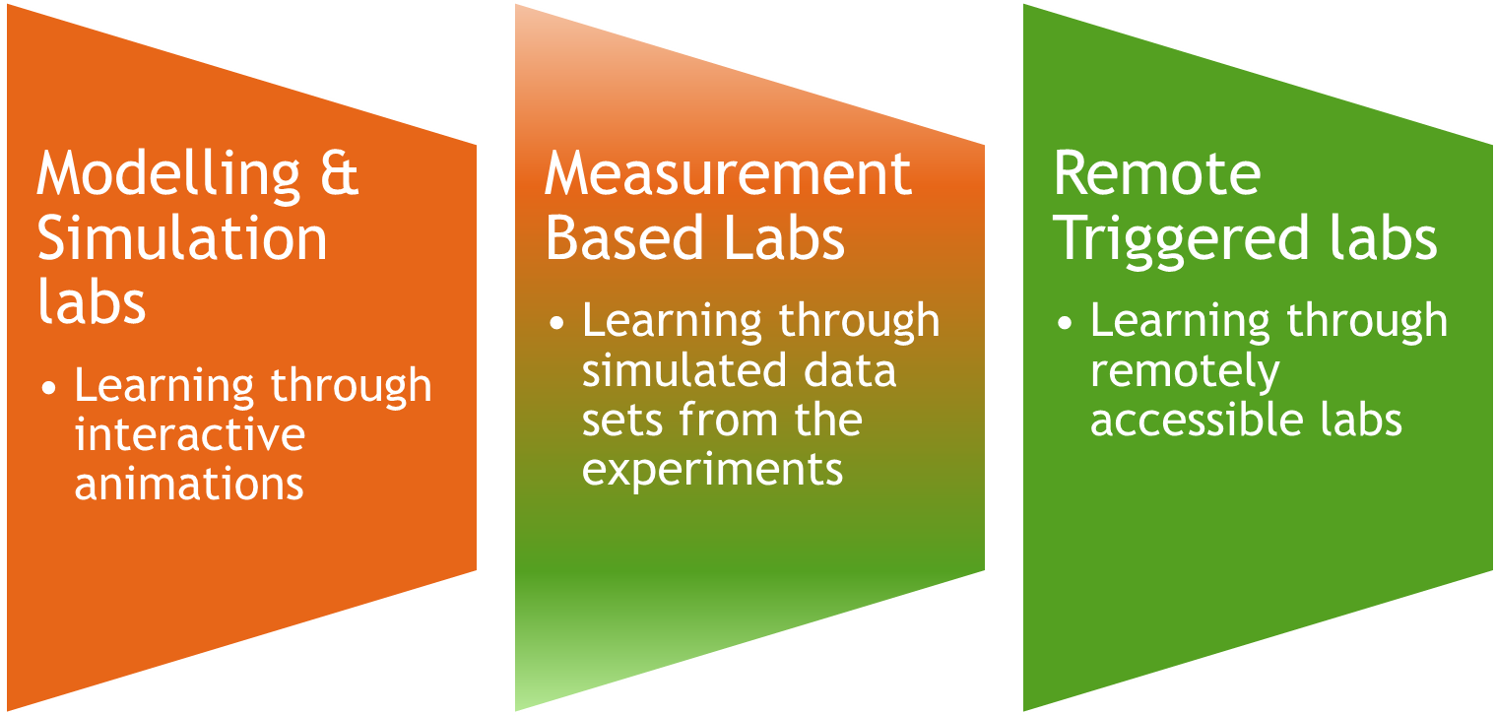
Types of Labs in Virtual Labs
© 2016, IIIT Hyderabad

Slide 9
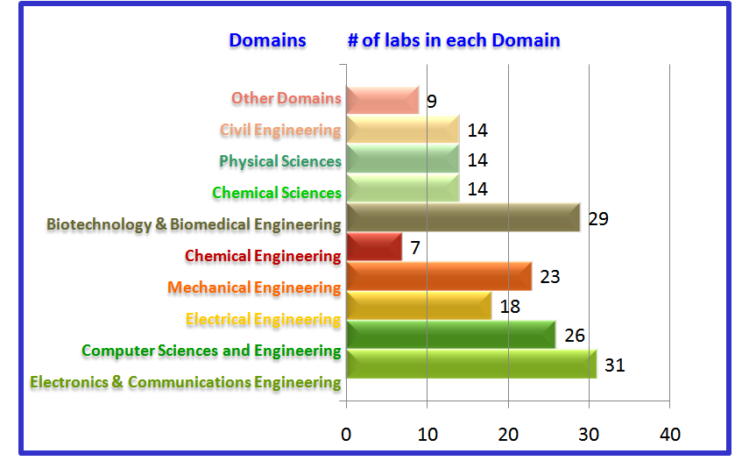
Spread of Labs- 10 Domains & over 185 Labs
These labs are available on Open edX platform.
Virtual Labs are an integrated set of experiments that form a “Learning Management System”
Provide information on the Usage, Student Preferences other data that is amenable to analytics.
© 2016, IIIT Hyderabad

Slide 10
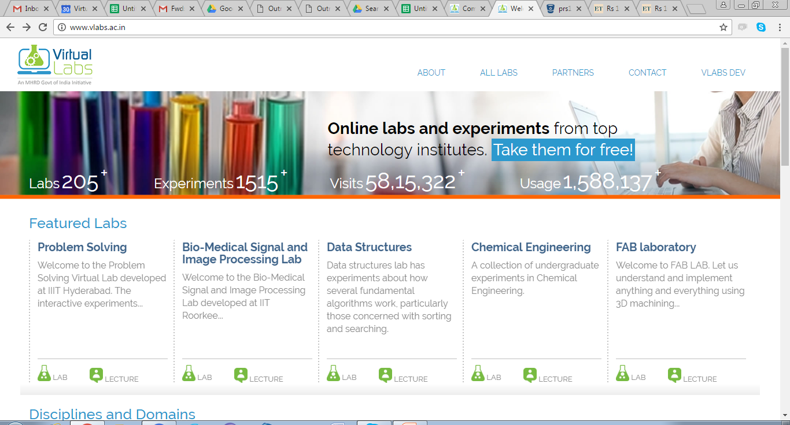
Virtual Labs on the net
All Experiments are accessible from this site- http://www.vlabs.ac.in with 185 Active Labs
31 upcoming.

Slide 11

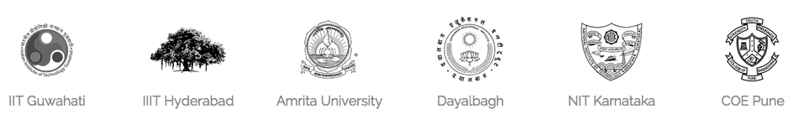
12 Partners
Experiments Developed by these 12 Partner Institutes-

Slide 12
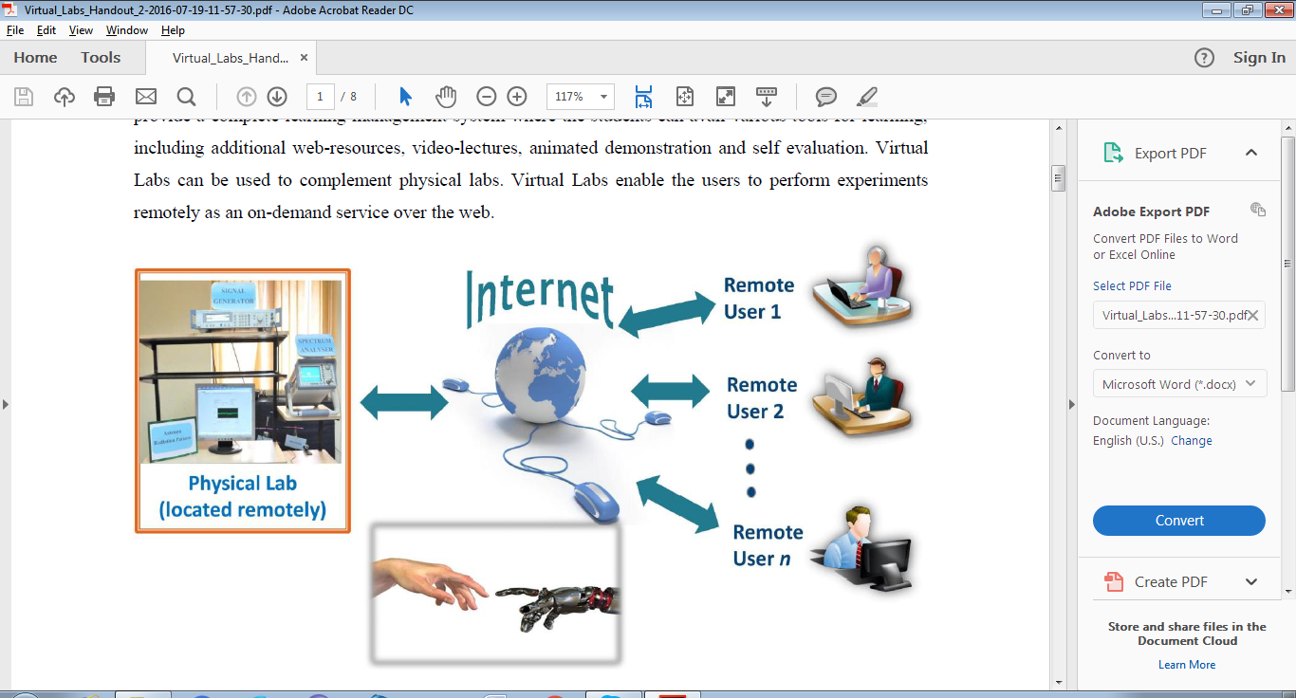
Virtual Labs Usage Architecture
185 Labs, 1500+ Experiments from 12 Institutes
15,88,000 Usages, 77100 Students, 325 Nodal Centers
College Students / Faculty/ Other Users largely on Open edX
College Students / Faculty/ Other Users largely on Open edX
College Students / Faculty/ Other Users largely on Open edX
Institute Developed Experiments / Labs on Cloud (AWS)
Virtual Lab Engineering and Architecture Divisions VLEAD
Outreach Program via Nodal Centers

Slide 13
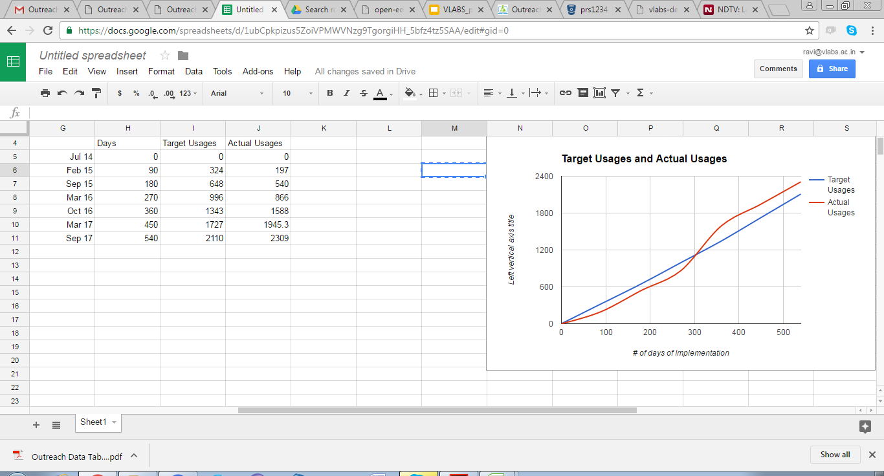
Impact - Outreach
15.88 Lakh Usages from 77100 students, 425 workshops, 325 Nodal Centers, 726 Workshops.
Labs completely linked to NPTEL
Recorded in the National Digital Library for posterity
Labs and Outreach being prepared for rapid growth - spread over colleges, Usages and alignment of experiments to the needs of colleges

Slide 14
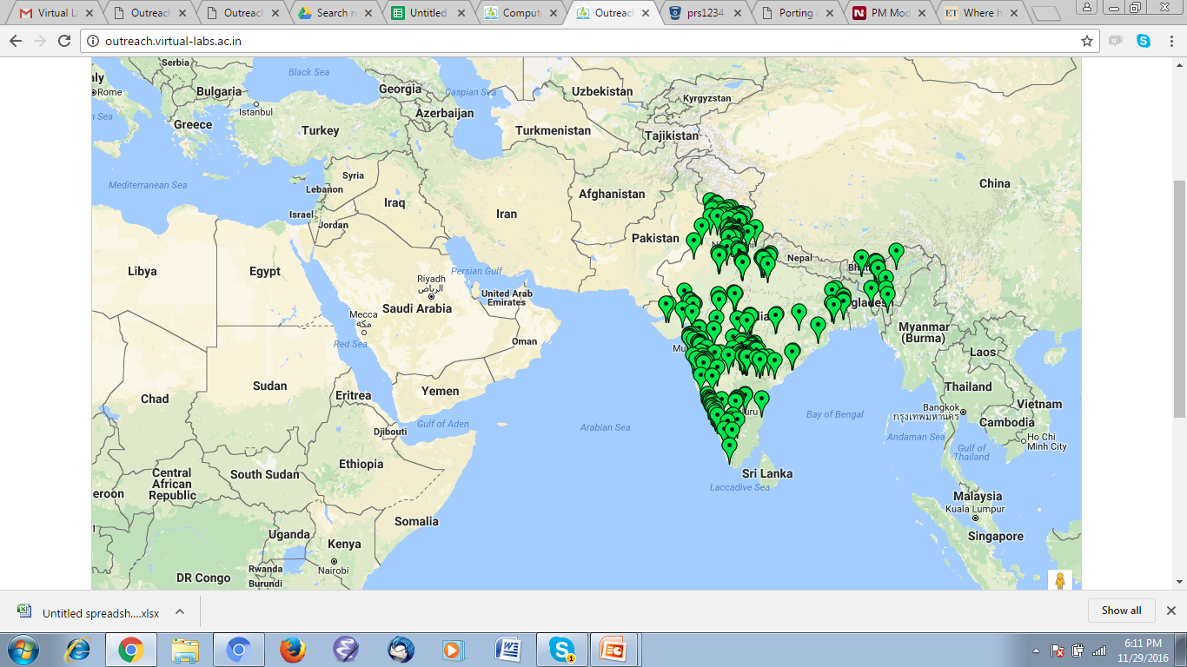
Impact – Outreach Network
Virtual Labs uses the Outreach Model to Evangelize and enthuse students
To engage private agencies ( Nodal Centers)for outreach of Virtual Labs and enthuse students
Build awareness about labs and usage
Provide a minimum level training to the local faculty members/research scholars in the colleges, through on-site workshops
College faculty engage their students in using the virtual labs.
identify the gaps in syllabi of universities & existing labs
Facilitate additional labs/experiments to fill these gaps.
Nodal Centers – 329- Workshops - 515 - Participants 7111; College Clouds – Under development
Mobile accessible Platform ( Open edX) with 68 labs

Slide 15
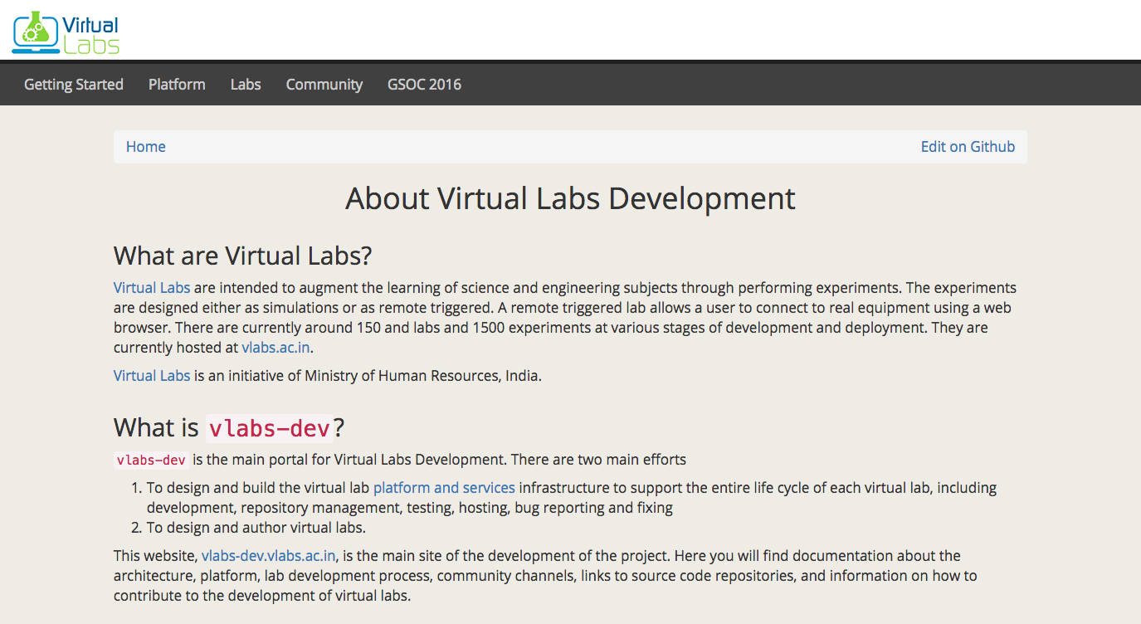
Contribute to Virtual Labs Development
Virtual Labs is an open source project. Pick up the projects you want to contribute at:
http://vlabs-dev.vlabs.ac.in

Slide 16
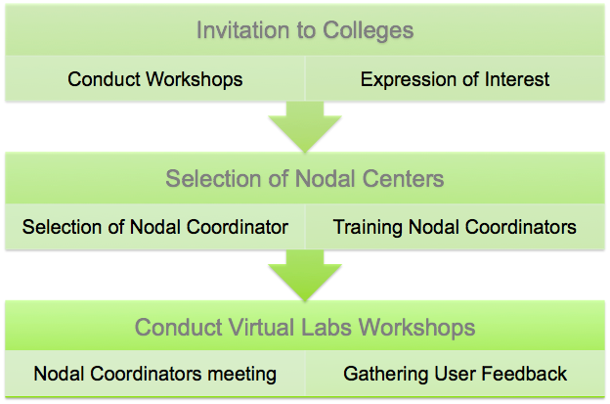
Partner with Virtual Labs
© 2016, IIIT Hyderabad
16

Slide 17
Advantages of being a Nodal Centre
The college will be on a National Map of MHRD undertaken project under ICT
Will be getting technical & financial support for training students, conducting workshops & developing own customized experiments
Students can undertake the development projects as their academic project.
As a Nodal centre, the college will be helping other colleges & schools nearby to spread the knowledge through ICT.
© 2016, IIIT Hyderabad

Slide 18
Thank You!
Access Virtual Labs at:
http://vlabs.ac.in
http://vlab.co.in
Virtual Labs
VLEAD, Vindhya C-6
IIIT Hyderabad, India
Virtual Labs web page: vlabs.ac.in
Technical feedback: engg@vlabs.ac.in
Jobs/internships: jobs@vlabs.ac.in
Contribute to Virtual Labs at:
http://vlabs-dev.vlabs.ac.in/gsoc-2016/ideas-list.html
Prof .Venkatesh Choppella
National Integration Coordinator
& Co-PI of Virtual Labs Project
Associate Professor, IIIT Hyderabad
Email: nic@vlabs.ac.in

